Slide 1
JNCIS-ENT
Open Shortest Path First (OSPF)

Slide 2
OSPF Adjacencies and Neighbors
3
Forming OSPF adjacencies with neighbors

Slide 3
What Makes a Neighbor?
Neighbors must exchange Hello packets
Neighbors are automatically discovered either on a broadcast, P2P or NBMA link
Neighbors which do not go on to form a full adjacency will stop the exchange process before exchanging any database information
Hello packets contain the following fields:
* These fields must match for 2 routers to become neighbors
Network mask*
Hello interval*
Dead interval*
Options*
Neighbors
Router Priority
Designated Router
Backup Designated Router

Slide 4
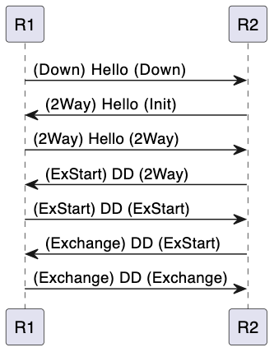
What is an Adjacency?
OSPF speaking routers form adjacencies with neighboring routers when they agree on certain parameters
These parameters ensure the data plane can forward traffic reliably
OSPF speaking routers synchronize their LSDBs during the adjacency formation process

Slide 5
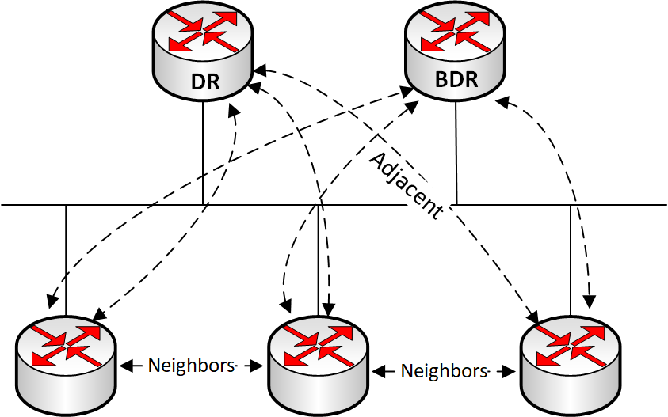
Neighborship vs. Adjacency
Neighboring routers are those which reside on the same broadcast domain and agree on the required parameters
This relationship means the 2 routers are aware of each other and participating in OSPF together however, they won’t necessarily exchange routing information
Adjacent routers are those which have completed the neighborship formation and go on to exchange routing information
On a broadcast link, this will only occur with the DR and BDR*
On a point-to-point link, this will occur with the other neighboring router on the link
Notes:
*DR and BDR will be explained in the next video

Slide 6
Configuring Basic OSPF
A router-id is not a required configuration for OSPF
If a router-id is not configured, the highest loopback IPv4 address is used as the router-id
If a loopback address is not configured, the highest interface IPv4 address is used
lab@SW1> show configuration protocols
ospf {
area 0.0.0.0 {
interface ge-0/0/2.0 {
priority 128;
}
}
}
lab@SW1> show configuration routing-options
router-id 1.1.1.1;

Slide 7
Monitoring Neighbors
lab@SW1> show ospf neighbor
Address Interface State ID Pri Dead 10.11.12.2 ge-0/0/2 Full 2.2.2.2 255 38
10.11.12.3 ge-0/0/2 Full 3.3.3.3 254 35
10.11.12.4 ge-0/0/2 2Way 4.4.4.4 128 38

